Slide 1

INFO 6105 – Final Project Amazon Fine Food Review Team: Flash Natural Language Processing
Bhavani Shankar Telaprolu – 001083390
Parag Laxmichand Shah – 001063214
Dongzhe Wu – 001304924
Chinwoo Haan – 001082279

Slide 2
Project Description:
The primary goal of this project is to find out whether the reviews present in the dataset are positive/negative
The dataset used is from Kaggle at https://www.kaggle.com/snap/amazon-fine-food-reviews
The data in this dataset is in two formats:
1. Comma Separated values (CSV)
2. SQLite
We are using SQLite Data to perform NLP operations on this data using k-NN model
Review score < 3 is considered as negative & Review score >3 is considered as positive

Slide 3
Workflow:
1. Sort data based on time
2. Convert reviews of "Amazon Fine Food Review" dataset into vectors using Bag of words
3. Split data into train and test
4. Find best hyperparameter by k-fold cross validation
5. Apply k-NN model on the train data
6. Find accuracy of the model
7. Print confusion matrix and plot error plot

Slide 4
Data Cleaning:
The given dataset has a lot of redundant data which is eliminated using duplicate function
The dataset contains “HN & HD”, helpful numerator and denominator which states the number of users find this data useful
Eliminated useless data by checking the condition HN<=HD
Sorted the data according to the time -> Time-based splitting

Slide 5
Text Pre-processing: (1)
Used Bag of Words model for preprocessing the text data present in the Amazon reviews
Regular expressions are used to remove any punctuations or any other special characters
Converted all the text to lowercase
Stemming is done by converting the word to it’s base word
Eg: helpful,helping,helps → help

Slide 6
Text Pre-processing: (2)
Lemmatizing is done by grouping the words that are considered as one
Eg: San Jose → SanJose
Removal of stop words is done by looping through the reviews
Eg: The food is very good
Common words like “The,food,is” are removed
Finally, the review is reduced to lower dimensions

Slide 7
Featurization of Bag of words & k-NN:
After looping through the reviews and processing of text, the final words are converted into vectors with lower dimension
Used Cross-validation concept to decide the hyperparameter “K”
k-fold cross-validation is done
Eliminated overfitting & underfitting
Trained/tested using k-NN model
Checked the accuracy & plotted the confusion matrix

Slide 8
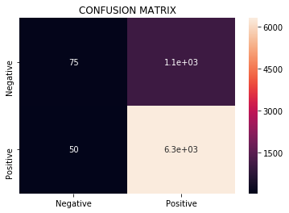
Observations & Results:
Applied Bag of words to convert text to vector
Hyperparameter for the k-NN model is 8
Got accuracy of 85.066667%
Thank you ☺

